Slide 1
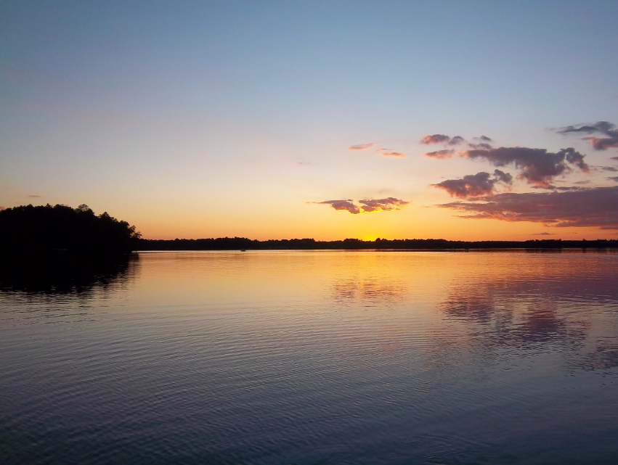

Sturgeon Chain Walleye Status Summary
Sturgeon Chain Workgroup
Presented by Dave Weitzel

Slide 2
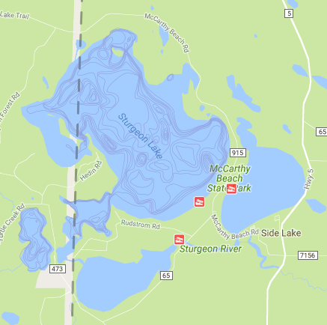
Walleye’s Preferred Physical Habitats
Walleye are most abundant in:
Large Lakes > 1,000
Relatively shallow lakes <30 feet deep
Lakes with high Alkalinity
Lakes with high Productivity
Lake | Acres | Depth
Sturgeon | 1,664 | 80
S. Sturgeon | 192 | 43
W. Sturgeon | 114 | 35
Lt. Sturgeon | 266 | 22
Side | 372 | 32

Slide 3
Sturgeon Chain Water Hardness and Fertility
Soft-Water
Hard-Water

Slide 4
Walleye’s Preferred Fish Community
Walleye are most abundant in lakes when
Yellow Perch are abundant (>8 per gill net)
Northern Pike catches are low

Slide 6
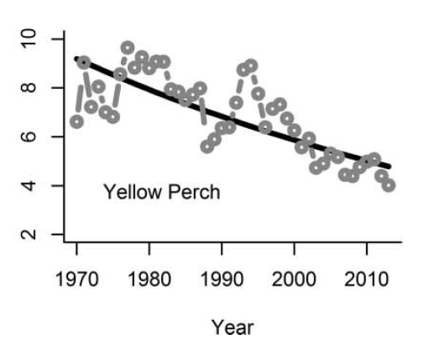
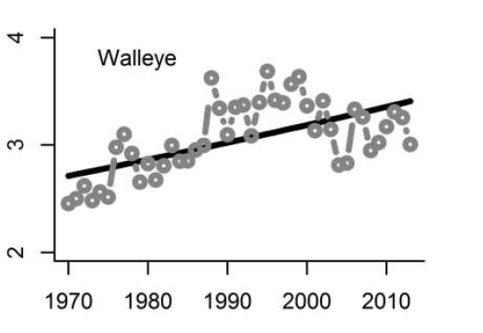
Statewide trends since the 1970s reflect changes observed on the Sturgeon Chain.
Notes:
Some coolwater fish, such as perch have decline, while walleye increased until 2000 but have since declined.

Slide 7
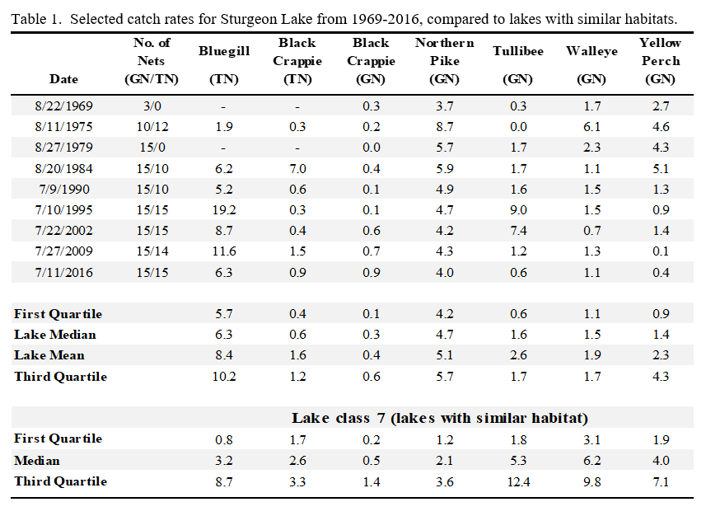
Note- 1975 catch was driven by a very strong 1972 year-class

Slide 8
20 Year Management History
Survey in 2002
Management Plan Revised in 2005
Survey in 2009
Management Plan Revised in 2010
Survey in 2016
Management Plan Revised in 2017
Gill net survey in 2023

Slide 9
2005-2015 Walleye Stocking Strategies
Sturgeon Lake-
  Fingerlings from 2003-2009 at one pound per littoral acre in odd years (moderate approach).
  Annual fry stocking from 2010-2015 (1,000 per littoral acre- aggressive approach)
Side Lake- Annual Fingerling stocking (1 pound per littoral acre- aggressive approach)
Little Sturgeon- Fingerling stocking every other year (typical approach)

Slide 10
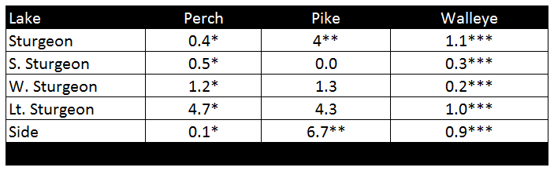
2016 Survey Results
*Perch catch is low compared to similar lakes
** Pike catch was high compared to similar lakes
*** Walleye catch was low compared to similar lakes

Slide 11
'05-’15
Annual Fingerling = 0.2/YC per net

Slide 12
'05-’15 Annual Fingerling = 0.2/YC per net

Slide 13
Density Dependent Survival
Young Walleye Catch Rate for Sturgeon Lake

Slide 14

Management Considerations
Poor survival of young Walleye at high stocking densities resulted in reduced catch rates and fewer fish for anglers
Goal: Provide a modest Walleye fishery that supports gill net catches of 2 fish per net.
Management action:
Reduce stocking frequency and amount
  Reduce density dependent mortality
  Reduce predation pressure on Yellow Perch
Encourage angler to release pike over 26 inches and harvest pike under 22 inches to reduce harvest pressure on perch

Slide 15
Recommended stocking plan
Stock fingerling walleye at a rate of ½ pound per littoral acre every other year in Sturgeon and Side lakes.
Allow private stocking if interest is expressed.
  Additional stocking by permit in 2021 (100 lbs) and 2023 (130 lbs)
Revisit stocking plan if perch numbers improve to over 8 per gill net.

Slide 16
Sampling plan
2023
Conduct a gill net only survey to evaluate walleye stocking in 2023 on Side, Sturgeon, and Little Sturgeon.
2028
Conduct a population assessment on all five lakes in 2028.

Slide 17
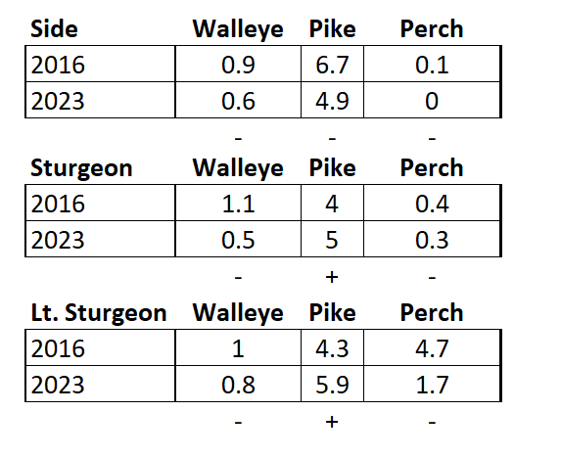
2023
Survey Results
Perch and Walleye numbers remained at or near all time lows, suggesting poor conditions for juvenile survival for these species. Goals were not met.
Northern Pike were caught in moderate numbers with good size quality. Bass electrofishing survey on Side Lake confirmed moderate numbers (43 per hour) and size quality.

Slide 18
'17-’22 Annual Fingerling = 0.2/YC per net

Slide 19
‘17-22
Annual Fingerling = 0.1/YC per net

Slide 20
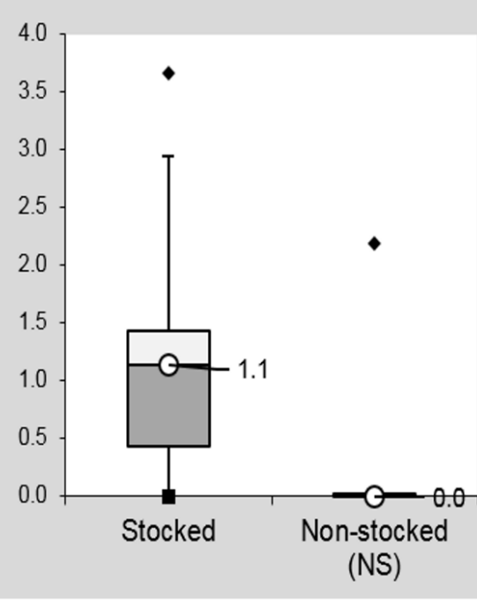
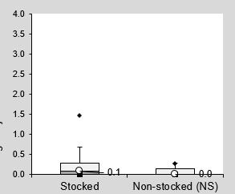
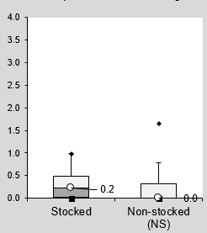
Observed Stocking Contributions
Average catch rate from stocked and non-stocked year-class
Wabana Lake
Sturgeon Lake (1973-2023) Side Lake (1977-2023)

Slide 21
Since 1991, only Pike River strain walleye have been used with similar results.

Slide 22
Insight from 2023 Survey
Recent stocking failed to improve the Walleye fishery
Conditions for Walleye mgt remain poor
Perch remain near all time lows
Good opportunities exist for quality Northern Pike and Largemouth Bass fisheries

Slide 23
Limitations of Walleye Stocking
May be an effective tool to overcome poor natural reproduction but can’t overcome other limiting factors.
Put, Grow, and Take strategy means that fish must survive four years to grow to a desirable size.
“No amount of stocking will make the lake over. It is useless to try to make a walleye lake into a trout lake, or a panfish lake into a walleye lake, by stocking.” - John B. Moyle, - From Two Centuries of Fish Propagation. MCV July/Aug 1948.

Slide 24
Where do we go from here?
Continue stocking plan through 2027
Allow private fish stockings
Largest size available is recommended
Survey in 2028
Revisit management plan in early 2029

